Slide 1
Benefits from the rapidly growing urbanization
St.Sebastian’s.College
Theshika Wellappili
Dillon DeZilva
Niron Pathiarana
Nisal Nethmin

Slide 2
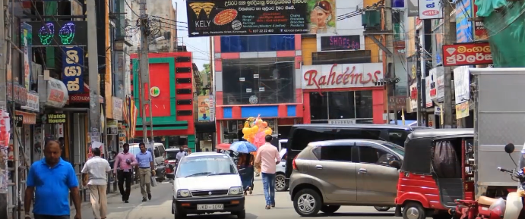
The generation of more employment opportunities thereby creation of economic growth.
One of the main aims of the government is full employment, with the expansion of companies and different institutions due to urbanization more job opportunities are created maintaining this rate at optimum.

Slide 3
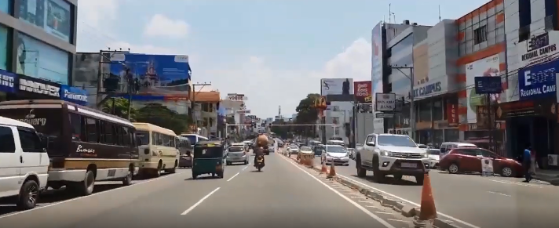
Upliftment in living standards
With the expansion of markets into rural areas due to urbanization proximity to major linkages has become easier for everyone in the presence of shops and outlets nearby has caused a major upliftment in living standards.

Slide 4
Utilization of rural resources also causing economic development
As a result of modernization of rural areas the organizations that spread into these areas tend to utilize rural resources that were degrading away.

Slide 5
Wide spread of technological developments into rural areas
With the markets spreading into rural areas it has caused a more technologically sound population in those areas. Thereby affecting the whole countries development, also affecting foreign trade and attracting investments as it creates a productive workforce.

Slide 6
Enhancement of supporting services
Supporting services such as banking, insurance, communication & transportation has had a major spike in its growth due to as mentioned in the previous slide the international intervention.

